Slide 1

Big Data and Cloud Computing
COMP 1702 Big Data
Lecture 10

Slide 2
Big Data and the Cloud
Typical scenario:
Big data projects traditionally start with data storage and application of basic analytics modules with in house infrastructure.
However, as you discover ways to extract data and data volumes increase, you need to find better way to process and analyse data, and this will require infrastructure upgrade
You add more server capacity to your in-house data lake but eventually the infrastructure will not be able to keep up. It is expensive and not scalable.
This is where the cloud can provide the ability to deal with Big Data more efficiently and effectively

Slide 3
Cloud computing
Cloud computing is the delivery of computing services – servers, storage, databases, networking, software, analytics, intelligence and more – over the Internet
The Cloud offers faster innovation, flexible resources and economies of scale.
You only pay for cloud services you use thereby lowering your operating costs, run your infrastructure more efficiently and scale as your business needs change.
Examples of Cloud providers: Amazon AWS & Microsoft Azure (currently the top 2 Cloud providers)

Slide 4
Benefits of Cloud Computing
Speed. Most cloud computing services are provided as self service and on demand. You can have them and release them in a short time.
Cost. It reduces the expense of buying hardware and software, and setting up and running on-site data centres
Scalability. It has the ability to scale elastically.
Productivity. IT teams can spend time on achieving more important business goals.

Slide 5
Virtualization – a solution for Hardware not being fully utilised ...
Average CPU utilisation in the data centre was surprisingly sometimes in single digits
Money was being wasted on IT assets that still were not being fully utilised
Virtualization is where you put multiple workloads on a single server.
Virtualization is a technology in which an application, guest operating system or data storage is abstracted away from the true underlying hardware or software.

Slide 6
Hosting strategy(Cloud Deployment Model)- 1
A public cloud environment is owned by an outsourced cloud provider and is accessible to many businesses through the internet on a pay-per-use model. It provides services and infrastructure to businesses who want to save money on IT operational costs. It’s the cloud provider who is responsible for the creation and maintenance of the resources.
Public clouds are ideal for small and medium sized businesses with a tight budget requiring a quick and easy platform in which to deploy IT resources.
Pros of a public cloud
Easy scalability
No geographical restrictions
Cost effective
Highly reliable
Easy to manage
Cons of a public cloud
Not considered the safest option for sensitive data
The lack of a bespoke service.

Slide 7
Hosting strategy(Cloud Deployment Model)- 2
Private cloud offers a more controlled environment in which IT resources are more centralised within the business. This model can be managed in-house. Private cloud hosting can be expensive, for larger businesses it can offer a higher level of security and more autonomy to customise the storage, networking and compute components to suit their IT requirements.
Pros of a private cloud
Improved level of security
Greater control over the server
Cons of a private cloud
Harder to access data from remote locations
Requires IT expertise

Slide 8
Hosting strategy(Cloud Deployment Model)- 3
Hybrid cloud is a good option for businesses seeking the benefits of both private and public cloud deployment models. By combining the two models, a hybrid cloud model provides a more tailored IT solution that meets specific business requirements.
Pros of a hybrid cloud
Highly flexible and scalable
Cost effective
Enhanced security
Cons of a hybrid cloud
Communication in network level may be conflicted as it’s used in both private and public clouds

Slide 9
Private and Hybrid clouds
In a private cloud, you create a cloud environment in your own data center and provide self-service access to compute resources to users in your organisation.
Private Cloud is the most secure of all cloud options
A hybrid cloud integrates public and private clouds
For example, you could host a high-scale website in the public cloud and link it to a highly secure database hosted in your private cloud

Slide 10
Service Models of Cloud Computing
IaaS (Infrastructure as Service). It Provides you the computing infrastructure, physical or virtual machines and other resources like virtual-machine disk image library, block and file-based storage, firewalls, load balancers, IP addresses, virtual local area networks etc. Examples: Amazon EC2, Microsoft Azure.
PaaS (Platform-as-a-Service). This is where cloud computing providers deploy the infrastructure and software framework, but businesses can develop and run their own applications. Web applications can be created quickly and easily via PaaS, and the service is flexible and robust enough to support them. Examples: java runtimes), Databases (e.g, mySql, Oracle), Web Servers (tomcat).
SaaS (Software as a Service). This cloud computing solution involves the deployment of software over the internet to various businesses who pay via subscription or a pay-per-use model. Examples: email (Office 365), Social Networking sites (Facebook)

Slide 11
Cloud Computing opportunities and Challenges
The use of the cloud provides a lot of opportunities:
– It enables services to be used without any understanding of their infrastructure.
– Cloud computing works using economies of scale:
• It potentially lowers the outlay expense for start up companies, as they would no longer need to buy their own software or servers
• Cost would be by on-demand pricing.
– Data and services are stored remotely but accessible from “anywhere”.

Slide 12
Cloud Computing opportunities and Challenges
There has been backlash against cloud computing:
– Use of cloud computing means dependence on others and that could possibly limit flexibility and innovation:
• The others are likely become the bigger Internet companies like Google and IBM, who may monopolise the market.
• Some argue that this use of supercomputers is a return to the time of mainframe computing that the PC was a reaction against.
– Security could prove to be a big issue:
• It is still unclear how safe out-sourced data is and when using these services ownership of data is not always clear.
– There are also issues relating to policy and access:
• What happens if the remote server goes down?
• How will you then access files?
• There have been cases of users being locked out of accounts and losing access to data.

Slide 13
Advantages of Cloud Computing
Lower computer costs:
– You do not need a high-powered and high-priced computer to run cloud computing's web-based applications.
– Since applications run in the cloud, not on the desktop PC, your desktop PC does not need the processing power or hard disk space demanded by traditional desktop software.
– When you are using web-based applications, your PC can be less expensive, with a smaller hard disk, less memory, more efficient processor...
– In fact, your PC in this scenario does not even need a CD or DVD drive, as no software programs have to be loaded and no document files need to be saved.

Slide 14
Advantages of Cloud Computing
Improved performance:
– With few large programs hogging your computer‘s memory, you will see better performance from your PC. 、
– Computers in a cloud computing system boot and run faster because they have fewer programs and processes loaded into memory…
• Reduced software costs:
– Instead of purchasing expensive software applications, you can get most of what you need for free-ish!
• most cloud computing applications today, such as the Google Docs suite.
– better than paying for similar commercial software
• which alone may be justification for switching to cloud applications.

Slide 15
Advantages of Cloud Computing
Unlimited storage capacity:
– Cloud computing offers virtually limitless storage.
– Your computer's current 1 Tbyte hard drive is small compared to the hundreds of Pbytes available in the cloud.
• Increased data reliability:
– Unlike desktop computing, in which if a hard disk crashes and destroy all your valuable data, a computer crashing in the cloud should not affect the storage of your data.
• if your personal computer crashes, all your data is still out there in the cloud, still accessible
– In a world where few individual desktop PC users back up their data on a regular basis, cloud computing is a data- safe computing platform!

Slide 16
Advantages of Cloud Computing
• Universal document access:
– That is not a problem with cloud computing, because you do not take your documents with you.
– Instead, they stay in the cloud, and you can access them whenever you have a computer and an Internet connection
– Documents are instantly available from wherever you are
• Latest version availability:
– When you edit a document at home, that edited version is what you see when you access the document at work.
– The cloud always hosts the latest version of your documents
• as long as you are connected, you are not in danger of having an outdated version

Slide 17
Advantages of Cloud Computing
Easier group collaboration:
– Sharing documents leads directly to better collaboration.
– Many users do this as it is an important advantages of cloud computing
• multiple users can collaborate easily on documents and projects
• Device independence.
– You are no longer tethered to a single computer or network.
– Changes to computers, applications and documents follow you through the cloud.
– Move to a portable device, and your applications and documents are still available.

Slide 18
Disadvantages of Cloud Computing
Requires a constant Internet connection:
– Cloud computing is impossible if you cannot connect to the Internet.
– Since you use the Internet to connect to both your applications and documents, if you do not have an Internet connection you cannot access anything, even your own documents.
– A dead Internet connection means no work and in areas where Internet connections are few or inherently unreliable, this could be a deal-breaker.

Slide 19
Disadvantages of Cloud Computing
Does not work well with low-speed connections:
– Similarly, a low-speed Internet connection, such as that found with dial-up services, makes cloud computing painful at best and often impossible.
– Web-based applications require a lot of bandwidth to download, as do large documents.
• Features might be limited:
– This situation is bound to change, but today many web- based applications simply are not as full-featured as their desktop-based applications.
• For example, you can do a lot more with Microsoft PowerPoint than with Google Presentation's web-based offering

Slide 20
Disadvantages of Cloud Computing
Can be slow:
– Even with a fast connection, web-based applications can sometimes be slower than accessing a similar software program on your desktop PC.
– Everything about the program, from the interface to the current document, has to be sent back and forth from your computer to the computers in the cloud.
– If the cloud servers happen to be backed up at that moment, or if the Internet is having a slow day, you would not get the instantaneous access you might expect from desktop applications.

Slide 21
Disadvantages of Cloud Computing
Stored data might not be secure:
– With cloud computing, all your data is stored on the cloud.
• The questions is How secure is the cloud?
– Can unauthorised users gain access to your confidential data?
• Stored data can be lost:
– Theoretically, data stored in the cloud is safe, replicated across multiple machines.
– But on the off chance that your data goes missing, you have no physical or local backup.
• relying on the cloud puts you at risk if the cloud lets you down.

Slide 22
Disadvantages of Cloud Computing
HPC Systems:
– Not clear that you can run compute-intensive HPC applications that use MPI/OpenMP!
– Scheduling is important with this type of application
• as you want all the VM to be co-located to minimize communication latency!
• General Concerns:
– Each cloud systems uses different protocols and different APIs
• may not be possible to run applications between cloud based systems
– Amazon has created its own DB system (not SQL 92)
• so your normal applications will have to be adapted to execute on these platforms.
Notes:
SQL-92 was the third revision of the SQL database query language. The DB system be a few minor incompatibilities.

Slide 23
Cloud Computing Platforms
Amazon Web Services (AWS) is a subsidiary of Amazon providing on-demand cloud computing platforms and APIs to individuals, companies, and governments, on a metered pay-as-you-go basis.
Microsoft Azure is a cloud computing platform created by Microsoft for building, testing, deploying, and managing applications and services through Microsoft-managed data centers. It provides software as a service (SaaS), platform as a service (PaaS) and infrastructure as a service (IaaS) and supports many different programming languages, tools, and frameworks, including both Microsoft-specific and third-party software and systems.

Slide 24
Components of Azure
Azure Synapse Analytics is the fast, flexible and trusted cloud data warehouse that lets you scale, compute and store elastically and independently, with a massively parallel processing architecture.
Azure Data Factory is a hybrid data integration service that allows you to create, schedule your ETL/ELT workflows.
Azure Blob storage is a Massively scalable object storage for any type of unstructured data-images, videos, audio, documents, and more-easily and cost-effectively.
Azure Databricks is a fast, easy, and collaborative Apache Spark-based analytics platform.
Azure Analysis Services is an enterprise grade analytics as a service that lets you govern, deploy, test, and deliver your BI solution with confidence.
Power BI is a suite of business analytics tools that deliver insights throughout your organization. Connect to hundreds of data sources, simplify data prep, and drive ad hoc analysis. Produce beautiful reports, then publish them for your organization to consume on the web and across mobile devices.

Slide 25
Amazon AWS

Slide 26
Amazon AWS
Amazon Web Services (AWS) is a collection of remote computing services (web services) that together make up a cloud computing platform, offered over the Internet by Amazon.com.
Website: http://aws.amazon.com
AWS is located in 9 geographical 'Regions‘. Each Region is wholly contained within a single country and all of its data and services stay within the designated Region.
Each Region has multiple 'Availability Zones', which are distinct data centers providing AWS services. Availability Zones are isolated from each other to prevent outages from spreading between Zones. However, Several services operate across Availability Zones (e.g. S3, DynamoDB).

Slide 27
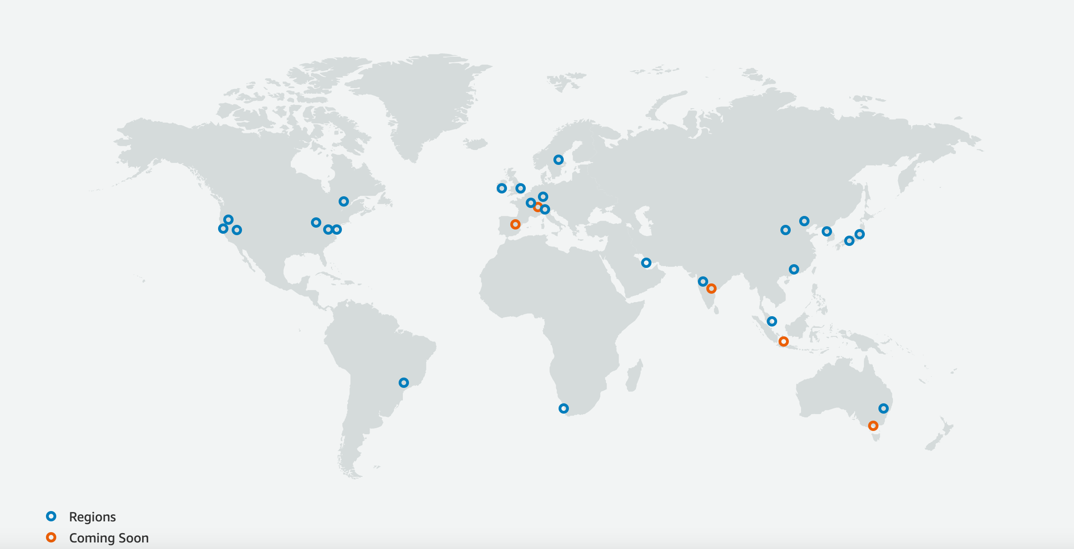

Slide 28
What is AWS Offering?
Low Ongoing Cost:, pay-as-you-go pricing with no up-front expenses or long-term commitments.
Instant Elasticity & Flexible Capacity: (scaling up and down) Eliminate guessing on your infrastructure capacity needs.
Speed & Agility: Develop and deploy applications faster Instead of waiting weeks or months for hardware to arrive and get installed.
Apps not Ops: Focus on projects. Let you shift resources away from data center investments and operations and move them to innovative new projects.
Global Reach: Take your apps global in minutes.
Open and Flexible: You choose the development platform or programming model that makes the most sense for your business.
Secure: Allows your application to take advantage of the multiple layers of operational and physical security in the AWS data centers to ensure the integrity and safety of your data.

Slide 29
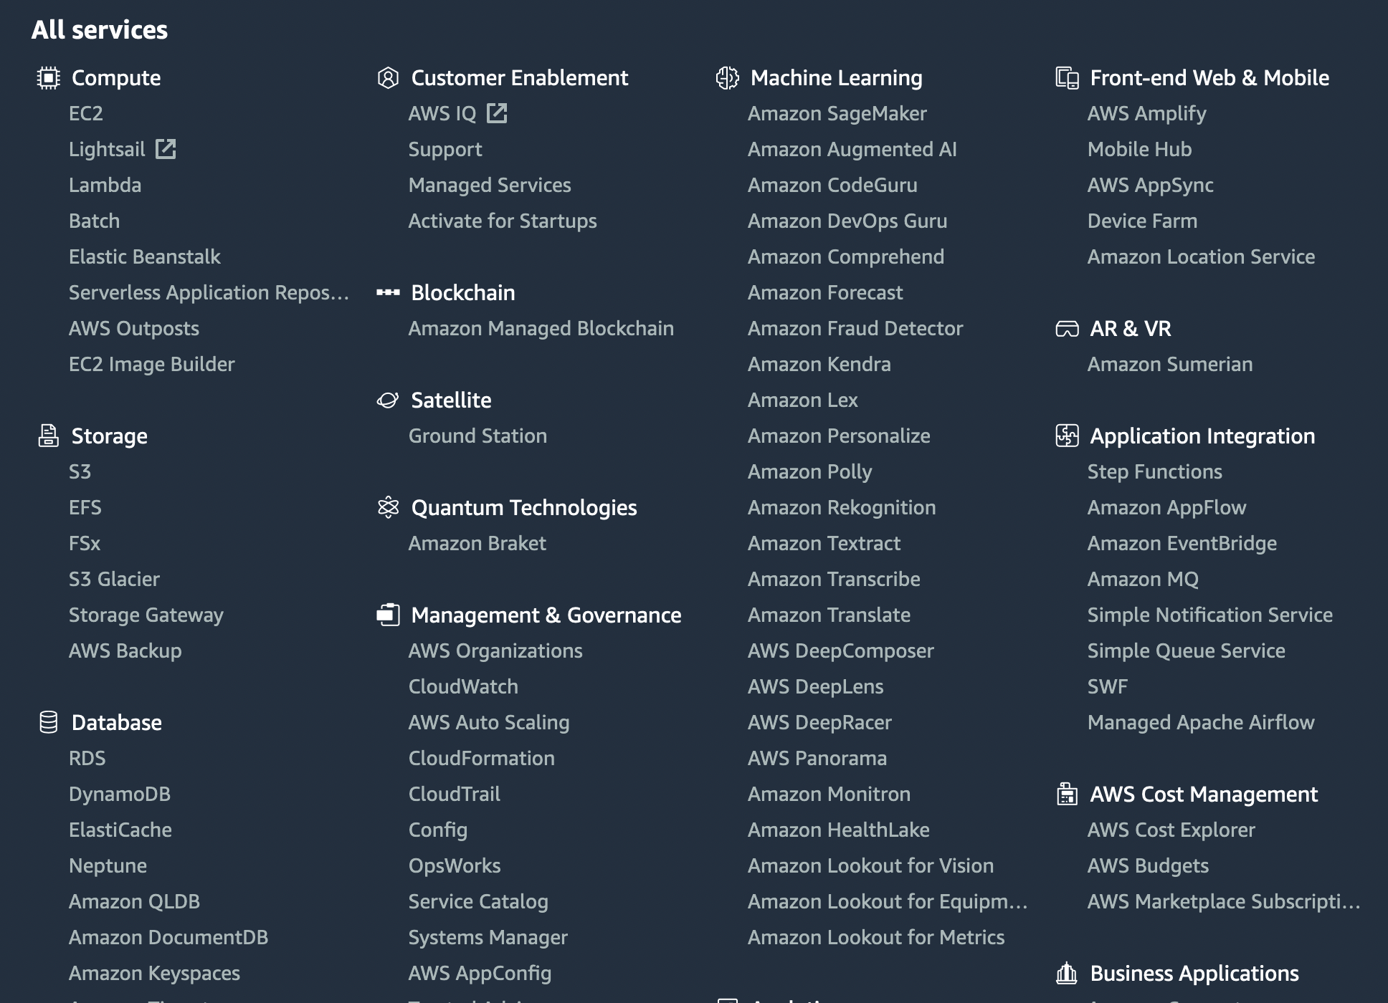

Slide 30
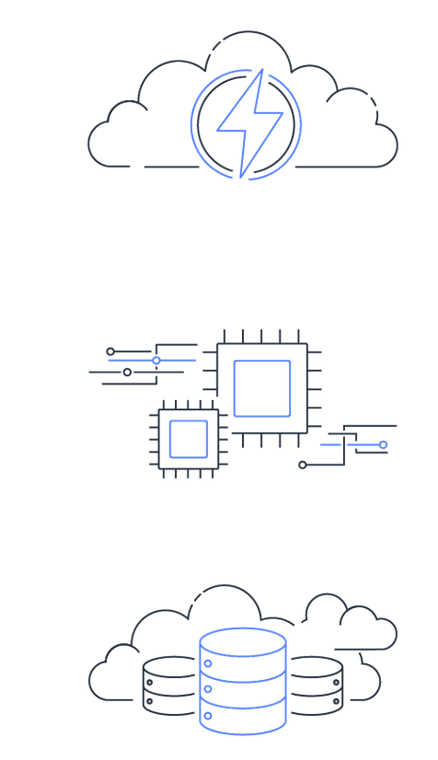

Amazon Elastic Compute Cloud (Amazon EC2)
Amazon Elastic Compute Cloud (Amazon EC2) is a web service that provides secure, resizable compute capacity in the cloud.
Amazon EC2 offers the broadest choice of instances, built on compute, storage, and networking technologies and engineered for high performance and security.
Faster innovation and increased security
with AWS Nitro System
Enhanced networking
Choice of processors
Choice of purchasing model
High performance storage

Slide 31
EC2 Instances
Micro instances (t1.micro):
Micro Instance 613 MiB of memory, up to 2 ECUs (for short periodic bursts), EBS storage only, 32-bit or 64-bit platform.
Standard Instances provide customers with a balanced set of resources and a low cost platform.
M1 Small Instance (Default) 1.7 GiB of memory, 1 EC2 Compute Unit (1 virtual core with 1 EC2 Compute Unit), 160 GB of local instance storage, 32-bit or 64-bit platform
M1 Medium Instance 3.75 GiB of memory, 2 EC2 Compute Units (1 virtual core with 2 EC2 Compute Units each), 410 GB of local instance storage, 32-bit or 64-bit platform
M1 Large Instance 7.5 GiB of memory, 4 EC2 Compute Units (2 virtual cores with 2 EC2 Compute Units each), 850 GB of local instance storage, 64-bit platform
M1 Extra Large Instance 15 GiB of memory, 8 EC2 Compute Units (4 virtual cores with 2 EC2 Compute Units each), 1690 GB of local instance storage, 64-bit platform
M3 Extra Large Instance 15 GiB of memory, 13 EC2 Compute Units (4 virtual cores with 3.25 EC2 Compute Units each), EBS storage only, 64-bit platform
M3 Double Extra Large Instance 30 GiB of memory, 26 EC2 Compute Units (8 virtual cores with 3.25 EC2 Compute Units each), EBS storage only, 64-bit platform

Slide 32
EC2 Payment methods
On-Demand Instances let you pay for compute capacity by the hour with no long-term commitments.
Reserved Instances give you the option to make a low, one-time payment for each instance you want to reserve and in turn receive a significant discount on the hourly charge for that instance.
Spot Instances allow customers to bid on unused Amazon EC2 capacity and run those instances for as long as their bid exceeds the current Spot Price.

Slide 33
Amazon Elastic Block Store (EBS)
Provides block level storage volumes (1 GB to 1 TB ) for use with Amazon EC2 instances.
Multiple volumes can be mounted to the same instance.
EBS volumes are network-attached, and persist independently from the life of an instance.
Storage volumes behave like raw, unformatted block devices, allowing users to create a file system on top of Amazon EBS volumes, or use them in any other way you would use a block device (like a hard drive).
EBS volumes are placed in a specific Availability Zone, and can then be attached to instances also in that same Availability Zone.
Each storage volume is automatically replicated within the same Availability Zone.
EBS provides the ability to create point-in-time snapshots of volumes, which are persisted to Amazon S3.
These snapshots can be used as the starting point for new Amazon EBS volumes, and protect data for long-term durability.
The same snapshot can be used to instantiate as many volumes as you wish.
These snapshots can be copied across AWS regions.

Slide 34
Amazon S3
Amazon Simple Storage Service (Amazon S3) is an object storage service. It provides a simple web services interface that can be used to store and retrieve any amount of data, at any time, from anywhere on the Web.
Amazon S3 concepts
Objects are the fundamental entities stored in Amazon S3.
A key is the unique identifier for an object within a bucket. Every object in a bucket has exactly one key. The combination of a bucket, key, and version ID uniquely identify each object.
A bucket is a container for objects stored in Amazon S3.
You can choose the geographical AWS Region where Amazon S3 will store the buckets that you create.

Slide 35
Using Amazon S3
Creating buckets – Create and name a bucket that stores data. Buckets are the fundamental containers in Amazon S3 for data storage.
Storing data – Store an infinite amount of data in a bucket. Upload as many objects as you like into an Amazon S3 bucket. Each object can contain up to 5 TB of data. Each object is stored and retrieved using a unique developer-assigned key.
Downloading data – Download your data or enable others to do so. Download your data anytime you like, or allow others to do the same.
Permissions – Grant or deny access to others who want to upload or download data into your Amazon S3 bucket. Grant upload and download permissions to three types of users. Authentication mechanisms can help keep data secure from unauthorized access.
Standard interfaces – Use standards-based REST and SOAP interfaces designed to work with any internet-development toolkit.

Slide 36

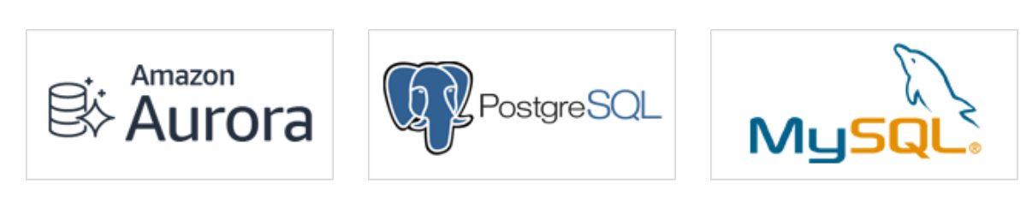
Amazon Relational Database Service (RDS)
Amazon Relational Database Service (Amazon RDS) makes it easy to set up, operate, and scale a relational database in the cloud.
It provides cost-efficient and resizable capacity while automating time-consuming administration tasks such as hardware provisioning, database setup, patching and backups.

Slide 37
Amazon DynamoDB
Amazon DynamoDB is a key-value and document database that delivers millisecond performance at any scale.
DynamoDB can handle more than 10 trillion requests per day and support peaks of more than 20 million requests per second.
Hundreds of thousands of AWS customers have chosen DynamoDB as their key-value and document database for mobile, web, gaming, ad tech, IoT, and other applications that need low-latency data access at any scale.

Slide 38
Amazon Redshift
Amazon Redshift is a data warehouse service which is fully managed by AWS. It is very simple and cost-effective because you can use your standard SQL and Business Intelligence tools to analyze huge amounts of data.
Use cases
Use Amazon Redshift to get sub-second results for reports, dashboards, and interactive analysis, and to get fast results for complex queries on any scale of data.

Slide 39
AWS Glue
AWS Glue is a data preparation service that makes it easy for data engineers to extract, clean, enrich, normalize, and load data. AWS Glue reduces the time it takes to start analyzing your data from months to minutes.
Use cases
Create, run, and monitor ETL jobs without coding
Create a unified catalog to find data across multiple data stores
Explore data with self-service visual data preparation

Slide 40
AWS Elastic MapReduce (EMR)
Amazon EMR is a managed cluster platform that simplifies running big data frameworks, such as Apache Hadoop Hive, Pig and Apache Spark on AWS to process and analyse vast amounts of data.
Amazon EMR is an AWS service that allows users to launch and use resizable Hadoop clusters inside of Amazon’s infrastructure.
It greatly simplifies the setup and management of the cluster of Hadoop and MapReduce components. EMR instances use Amazon’s prebuilt and customized EC2 instances, which can take full advantage of Amazon’s infrastructure and other AWS services.

Slide 41
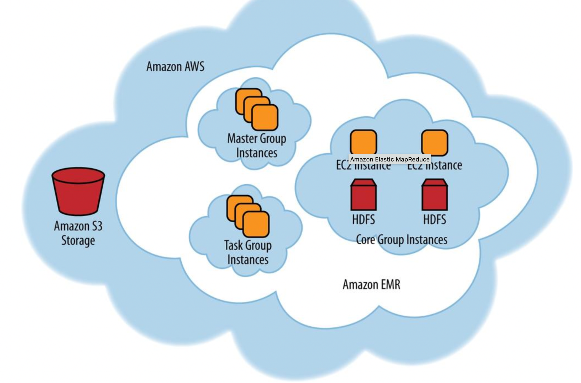
Architectural of EMR cluster
The master, core, and task cluster groups perform the following key functions in the Amazon EMR cluster:
Master group instance
Core group instance
Task group instance

Slide 42
Thanks!

